Slide 1
Git Workflow

Slide 2
Create Branch From that week’s branch (week_four)
We need to be in the week_four(main branch), then we checkout to new branch using Command: git checkout –b team_member_name_task_doing
After completing the task. Commit all the code changes and push it to your remote branch
Since we pushed the code to remote branch. Now we checkout to the week_four branch(main branch for that week) using command : git checkout week_four
Now pull the week_four remote branch data, to see it your local week_four branch is up to date or not
Then checkout out to your own branch. Command: git checkout team_member_name_week_number_task_doing

Slide 3
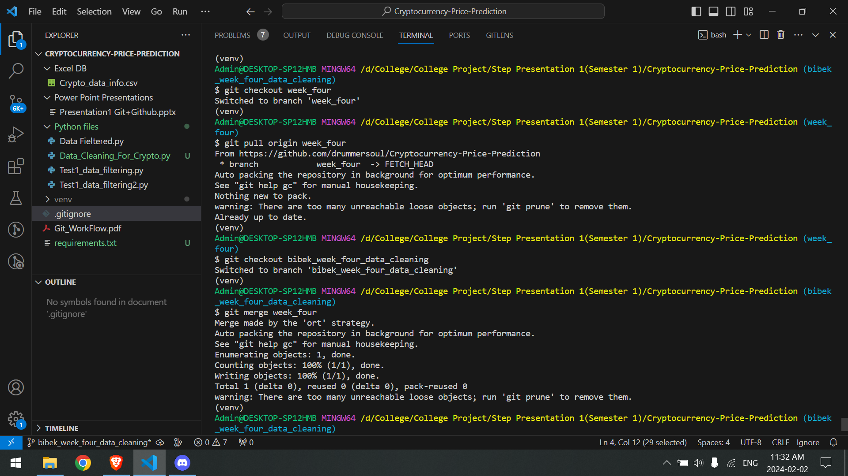
Set of Pushing the code and pulling the remote branch

Slide 4
Merge Week_four branch to your branch
Once you are in your branch. Merge the week_four branch to your branch. Command: git merge week_four
If there is conflict with the file, please contact the team member with who’s code you are having conflict with.
After the issue has been resolved. Create a pull request from github and add reviewer: project lead
Code will be reviewed then merge to the week_four branch(main branch for that week)
Visual Representation is added in next slide:

Slide 5
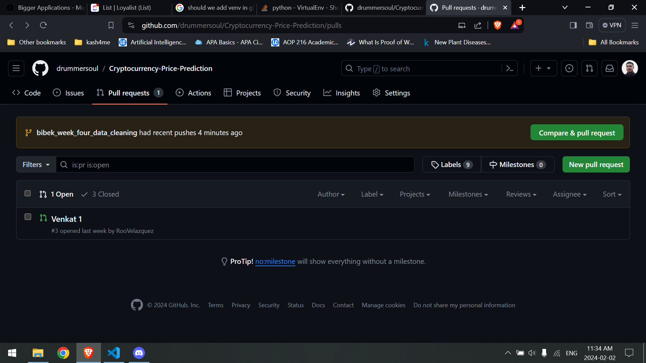

Slide 6
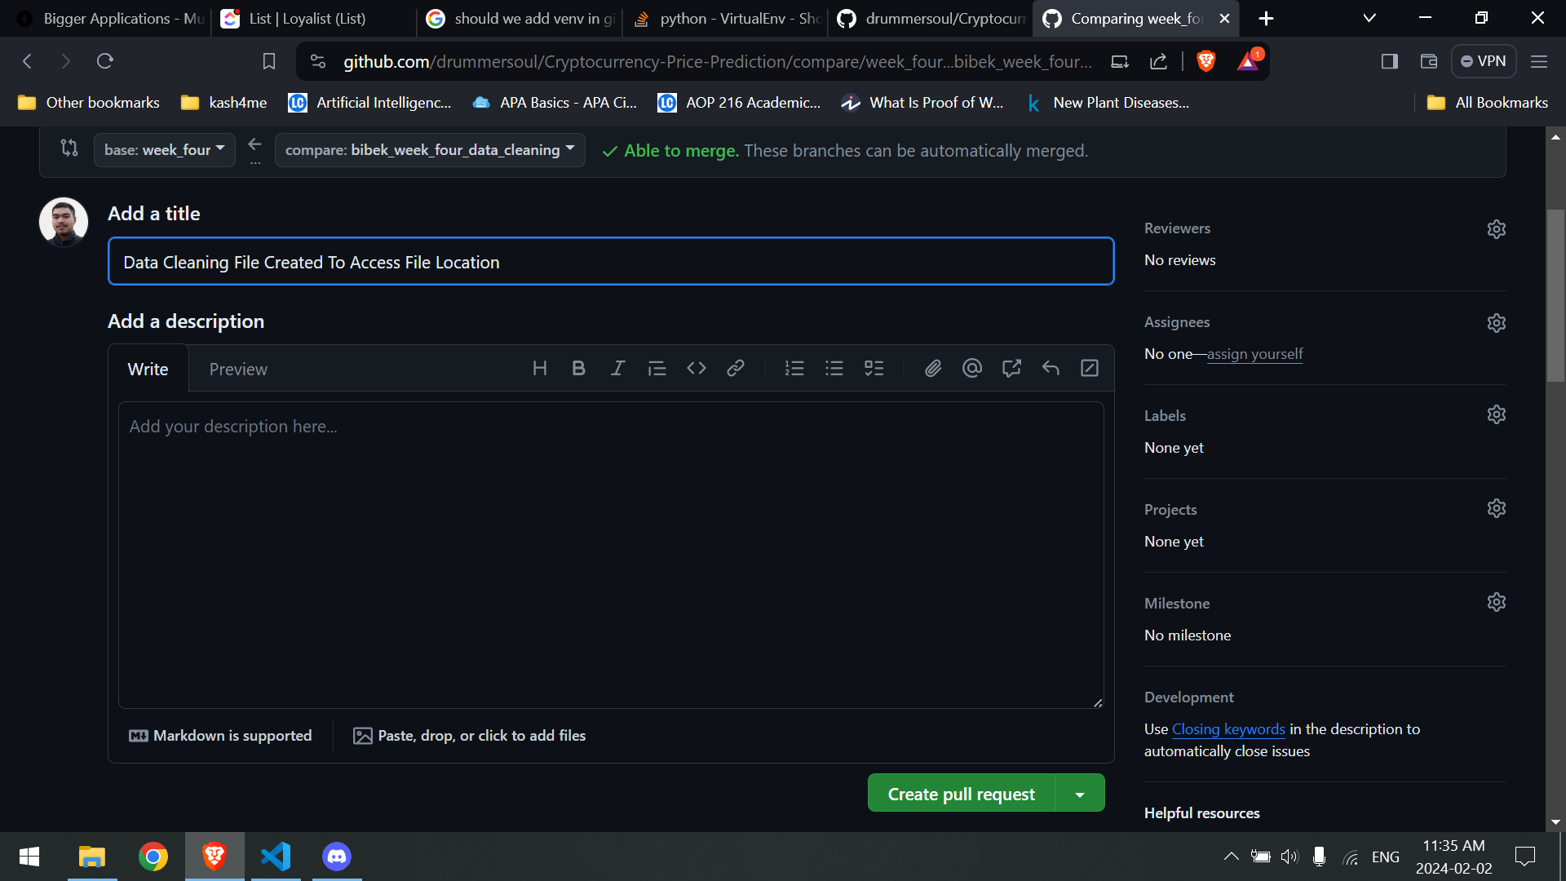

Slide 7
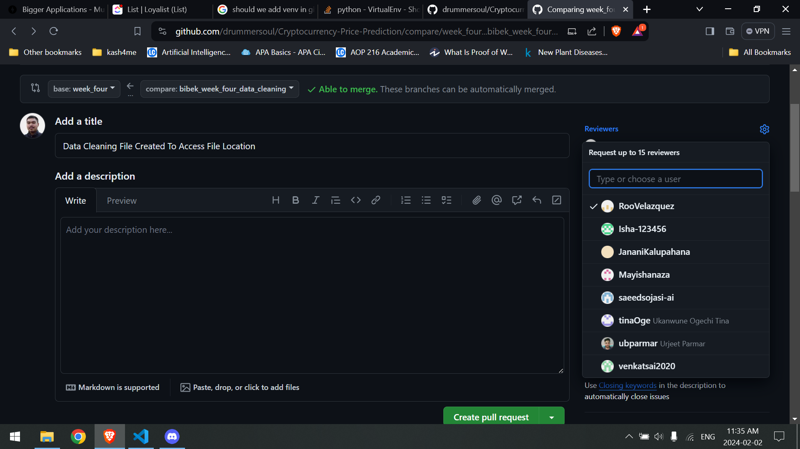
Adding Reviewer To Merging the Code

